Slide 1
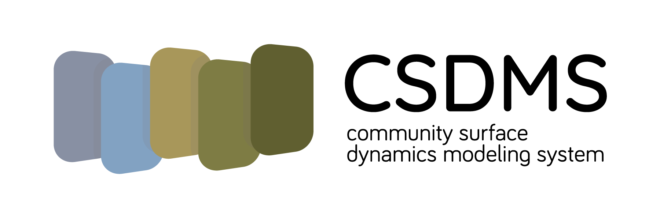
Exploring Surface Processes using Community Surface Dynamics Modeling System Modeling Tools: How to Build Coupled Models
GSA Short Course
October 2020

Slide 2
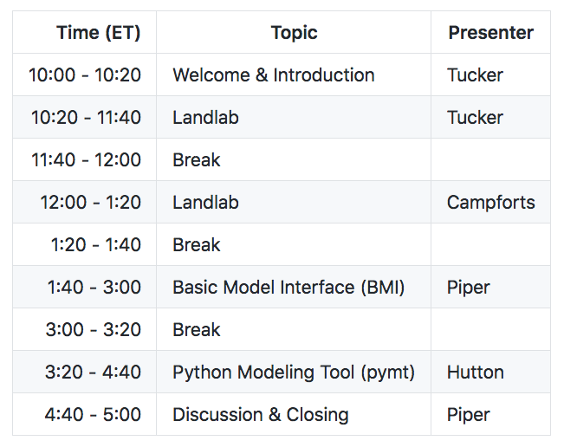
Agenda

Slide 3



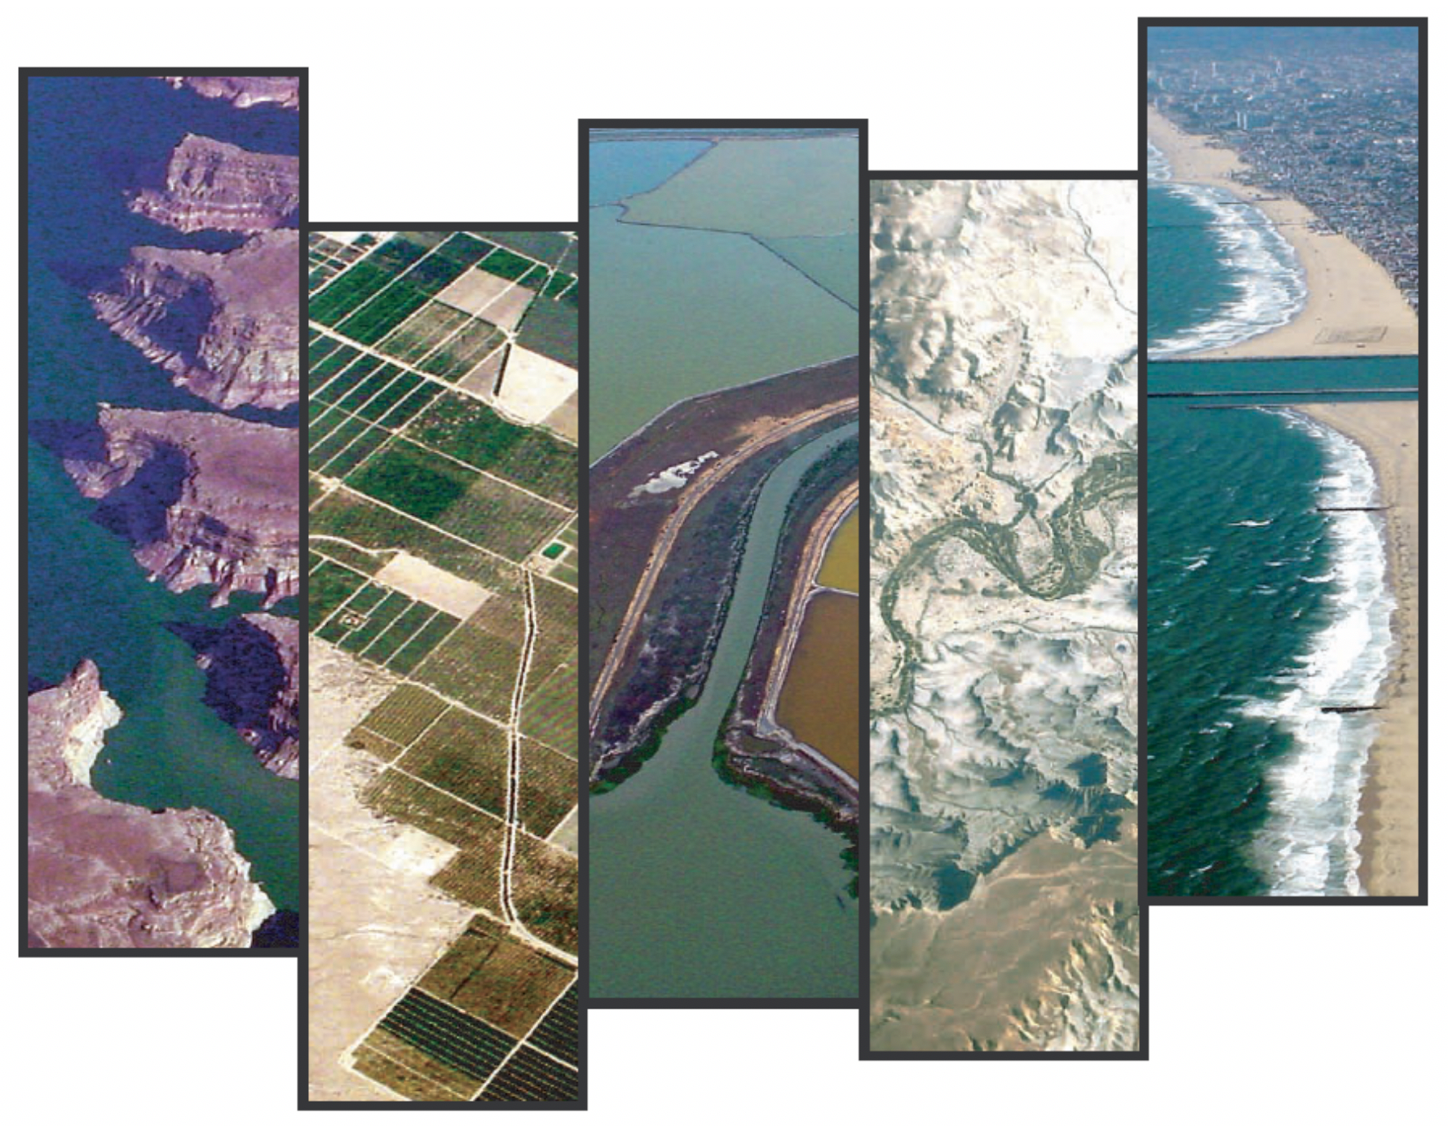

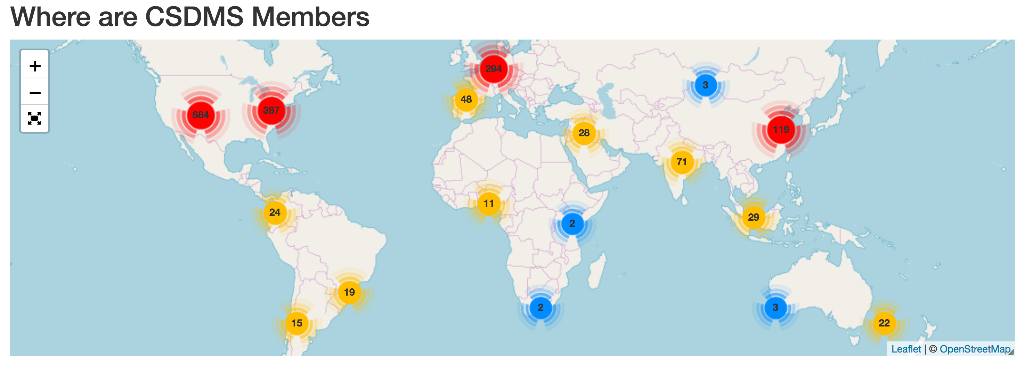

*
CSDMS supports computational modeling in earth-surface science by engaging community, providing computing resources, and promoting education
share resources, collaborate
create, run, test, analyze, and apply models
learn and teach
Earth-surface processes
1980 members
72 countries
~640 institutions
COMMUNITY
SUPPORT
COMPUTING
RESOURCES
EDUCATION
OPPORTUNITIES
Integration Facility at
(*pronounced “systems”)
https://csdms.colorado.edu

Slide 4
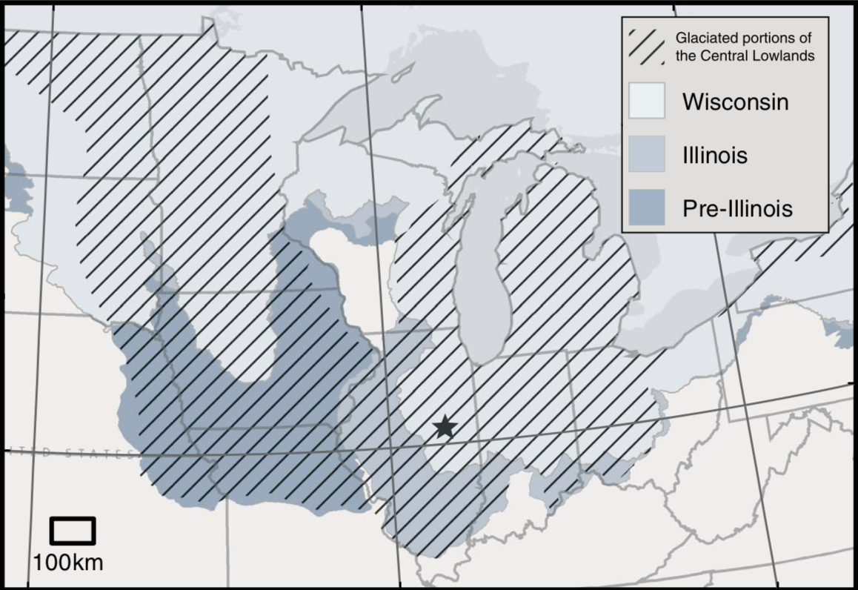
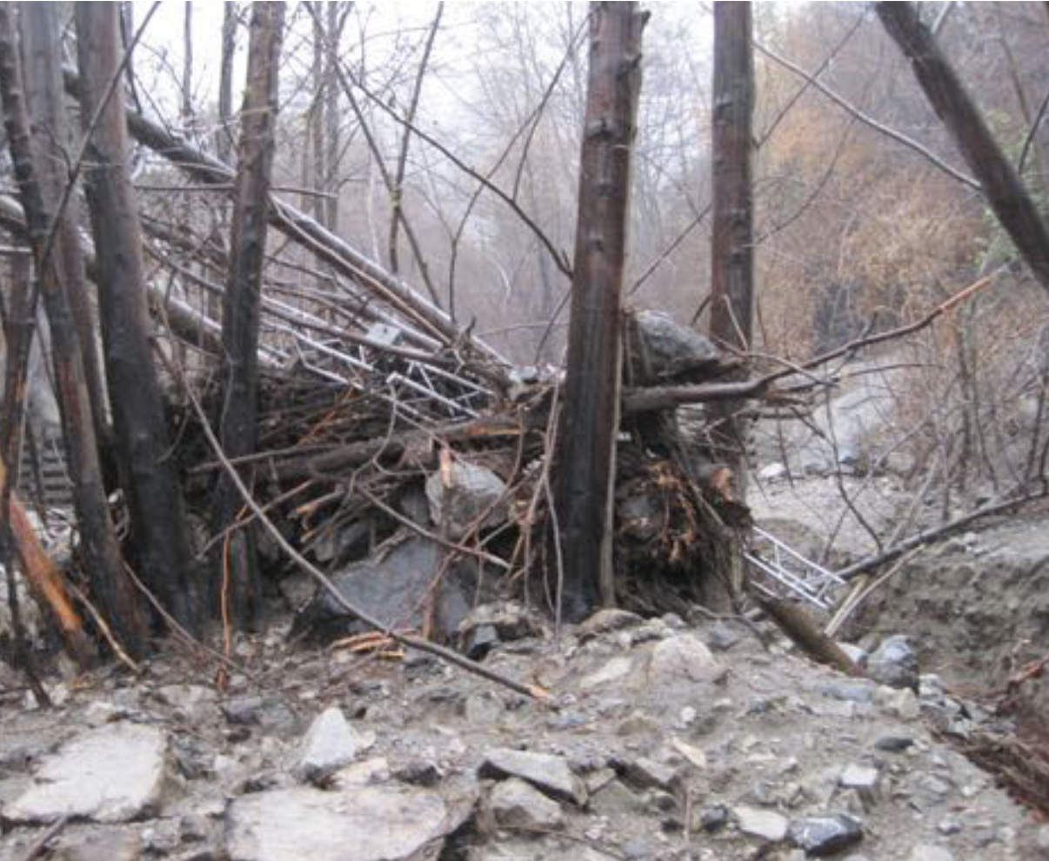
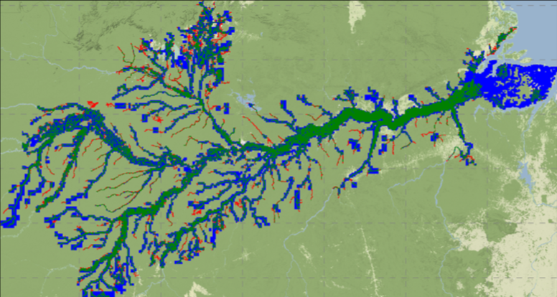
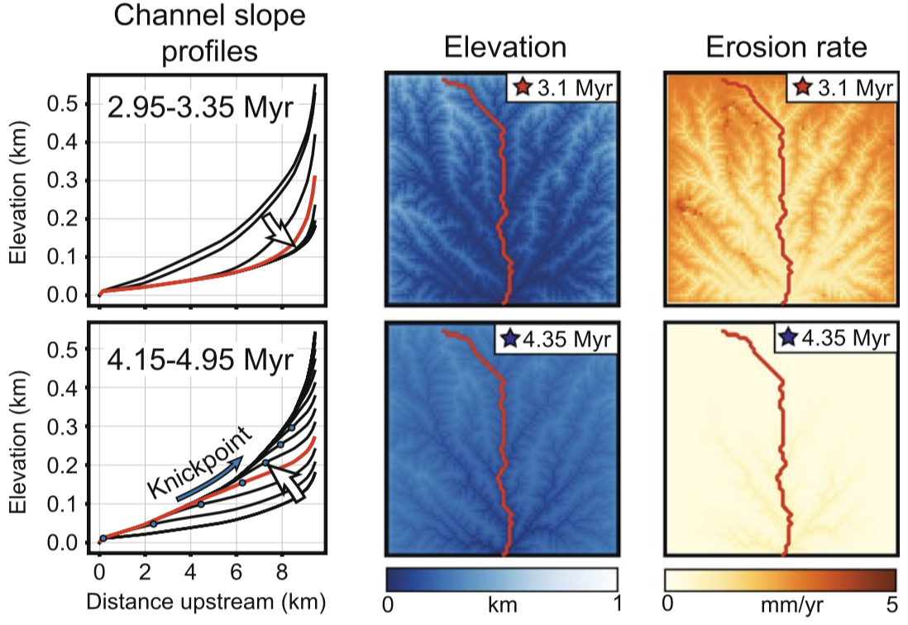
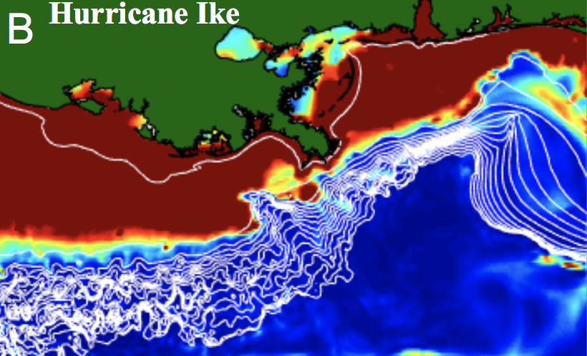
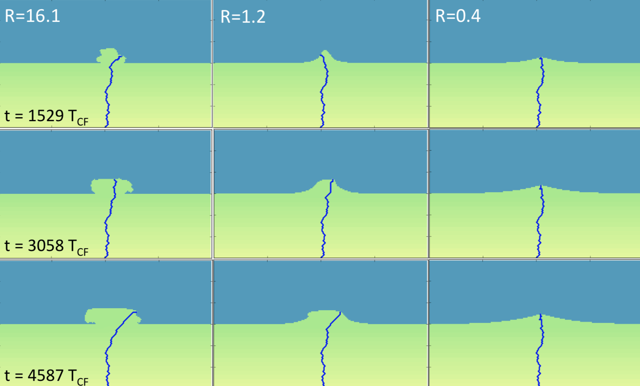
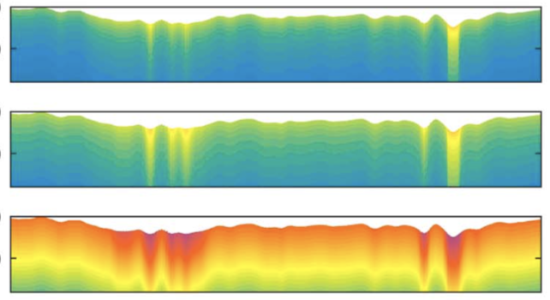
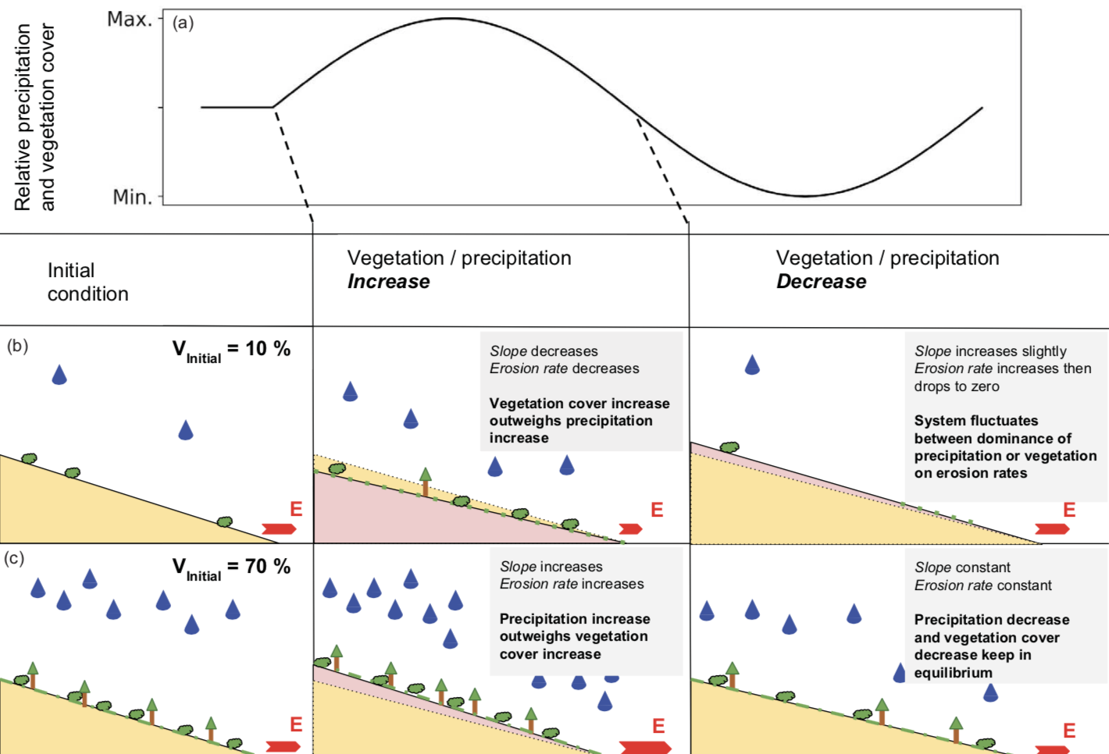
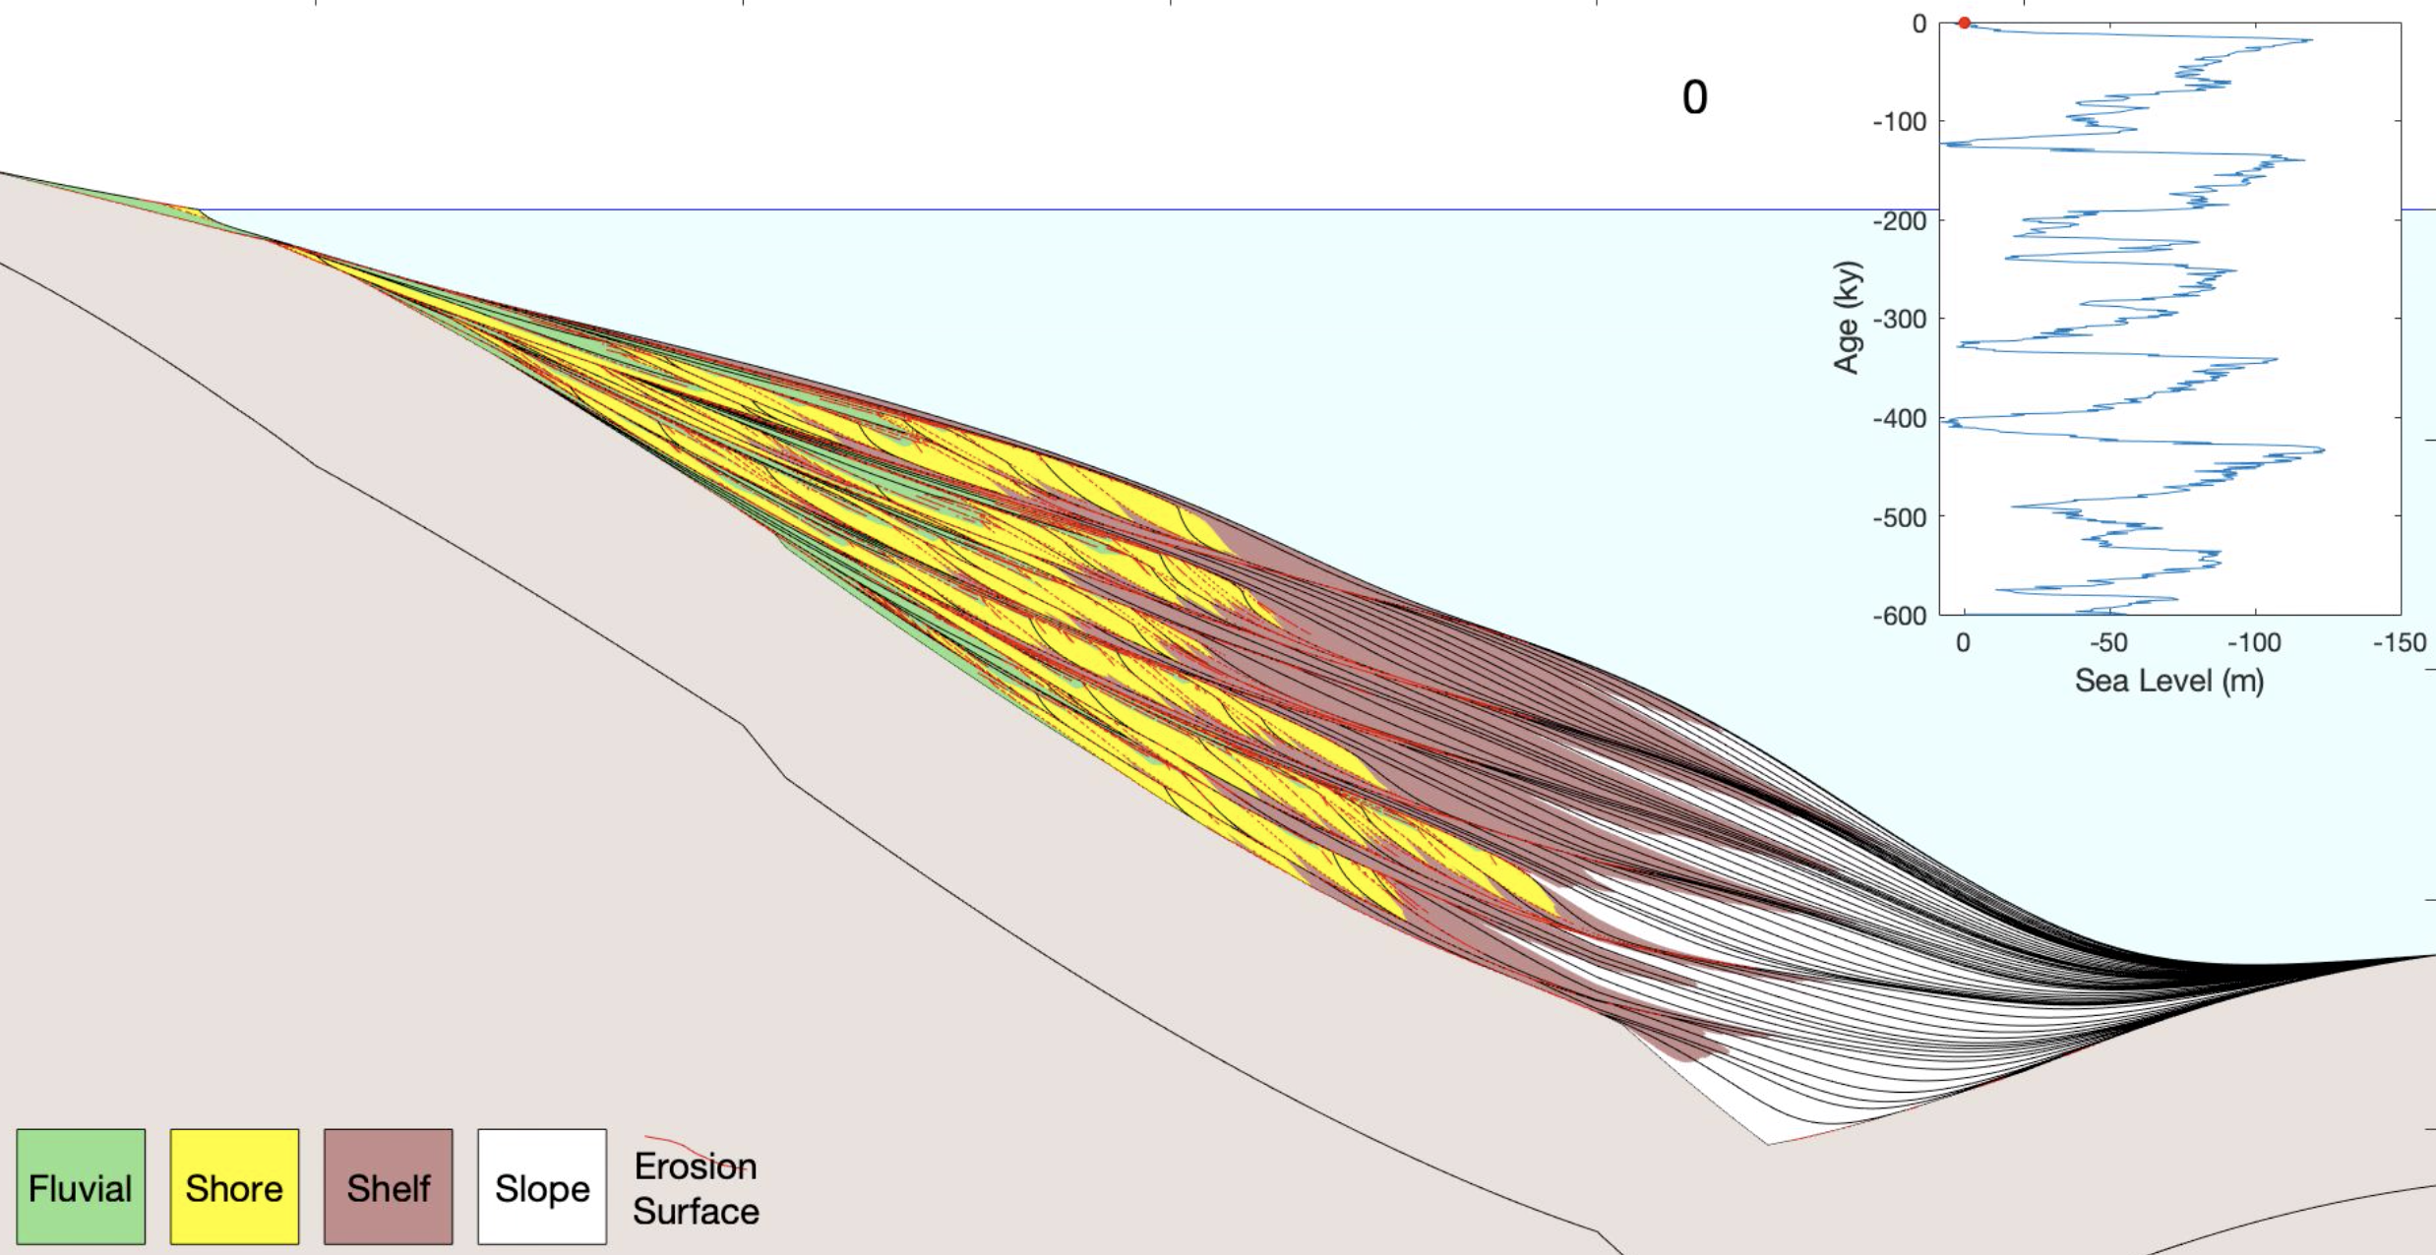
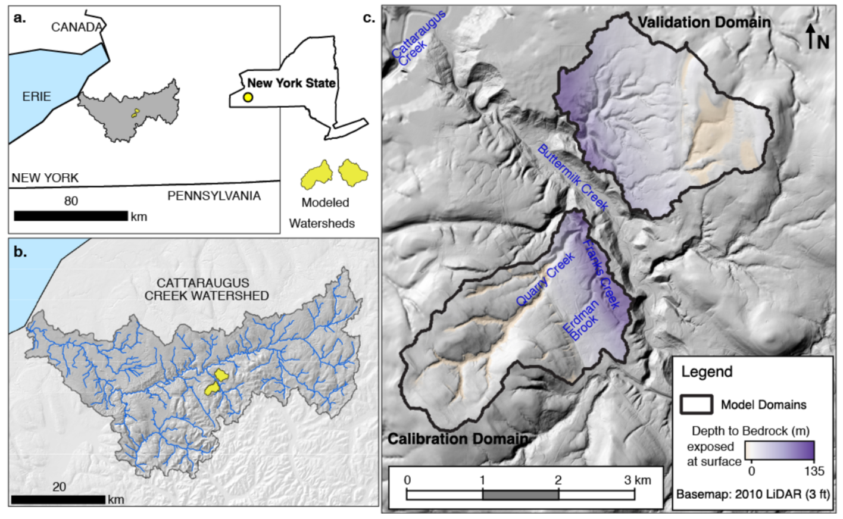
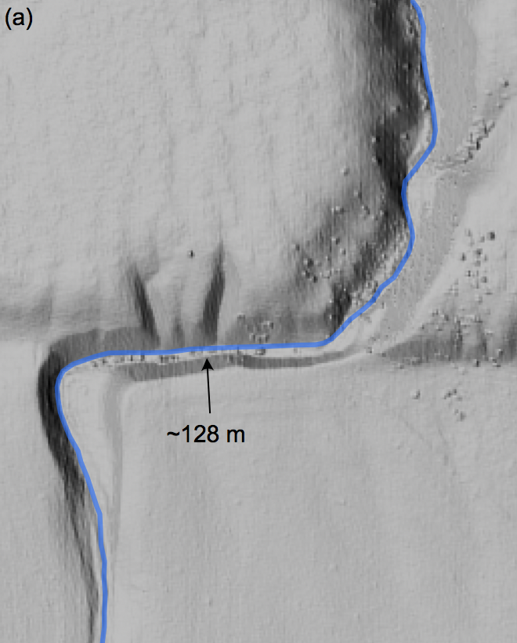
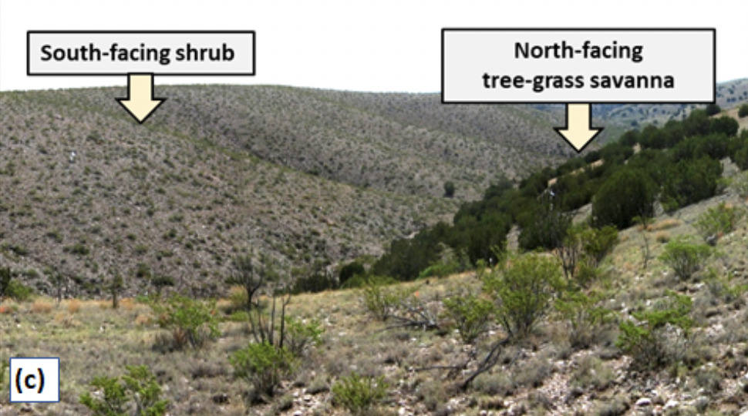
Examples of community research questions*
How do drainage networks form after glaciation?
Can we better predict flood inundation?
How do hurricanes trigger deep-sea turbidity currents?
How will permafrost melt impact Arctic slopes?
How are climate and sea level cycles reflected in marine stratigraphy?
When does stream offset accurately record fault slip?
How can we efficiently predict debris-flow timing?
Can sediment provenance reveal environmental signals in stratigraphy?
How will sea-level rise impact coastal deltas?
How do cycles in climate and vegetation influence landscape evolution?
Can we forecast erosion at hazardous waste sites?
Can changes in grazing and wildfire regime trigger woody plant encroachment?
* addressed using CSDMS technology
Notes:
Applied

Slide 5
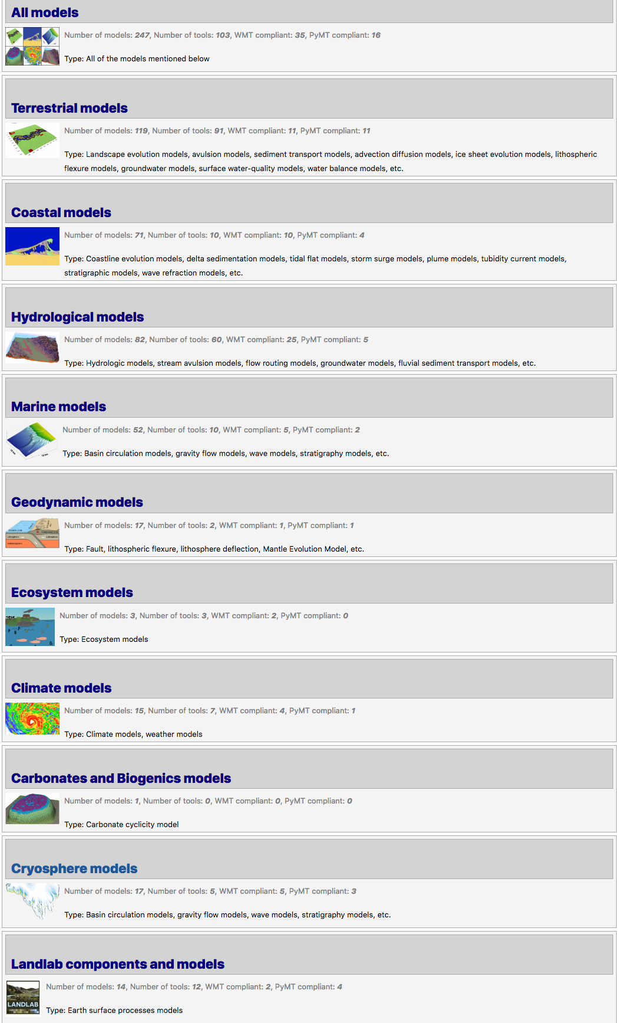
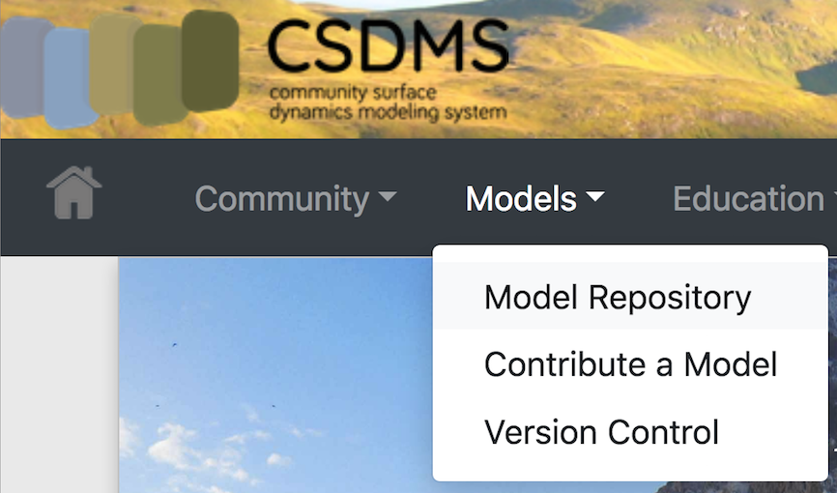
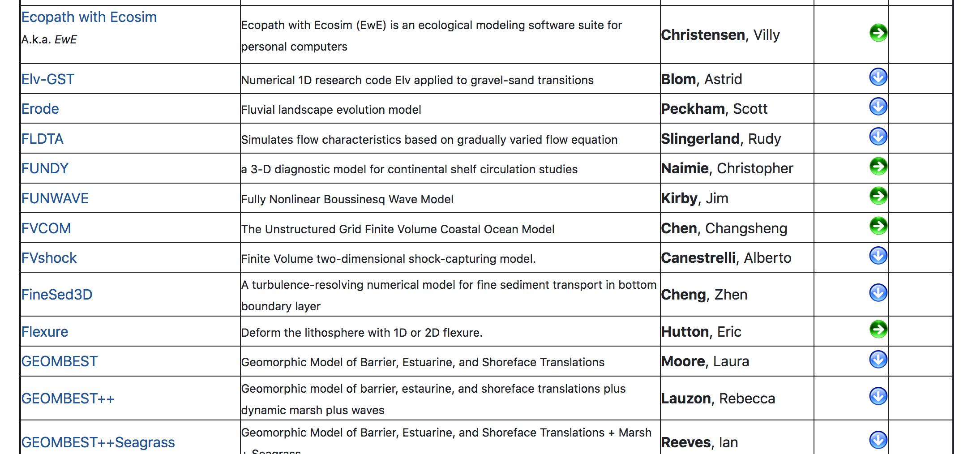
Model Repository
266 Models
117 Tools
…
…
Community open catalog & repository for modeling software and tools
Full metadata for each program
Contributors can obtain Digital Object Identifier (DOI) to make product citable
>2,100 references
CSDMS tracks h-index for programs based on bibliography
COMMUNITY

Slide 6

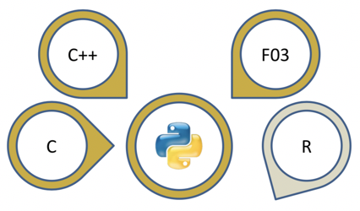


Software Cyberinfrastructure: CSDMS Modeling Framework
“CSDMS is envisioned as a modeling environment containing a community-built, freely available suite of integrated, ever-improving software modules aimed at predicting the erosion, transport, and accumulation of sediment and solutes in landscapes and sedimentary basins over a broad range of time and space scales.”
- Science Plan, 2004
Interface standard (BMI)
Language interoperability (Babelizer)
Model-building toolkit (Landlab)
Execution and coupling framework (PyMT)
COMPUTING

Slide 7
Building 2D Numerical Models with Landlab

Slide 8
Spatially distributed (2D) process models are vital for studying earth’s surface
… and model codes have some interesting things in common
CATCHMENT HYDROLOGY
(Ivanov et al., 2004)
SOIL EROSION
(Mitas and Mitasova, 1998)
GLACIER DYNAMICS
(Kessler et al., 2006)
LANDSCAPE EVOLUTION
(Tucker and Hancock, 2010)
IMPACT CRATERING AND DEGRADATION
(Howard, 2007)
LAVA FLOWS
(Kelfoun et al., 2009)

Slide 9


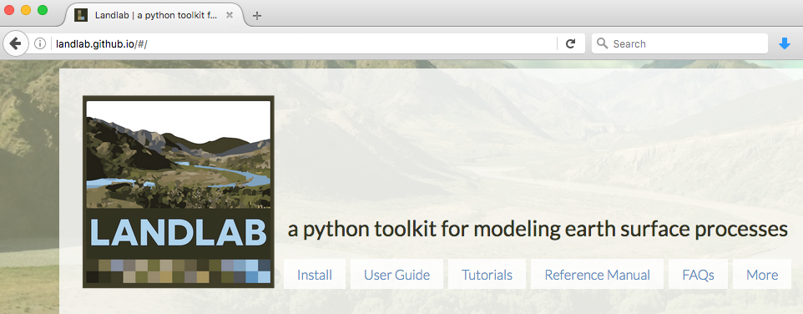
What is Landlab?
A Python-language programming library
Supports efficient creation and/or coupling of 2D numerical models
Geared toward (but not limited to) earth-surface dynamics
Companion to CSDMS Python Modeling Tool (PyMT)
landlab.github.io

Slide 10
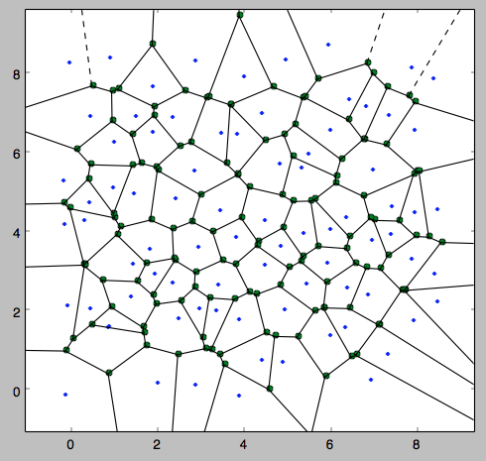
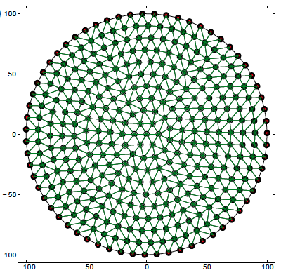
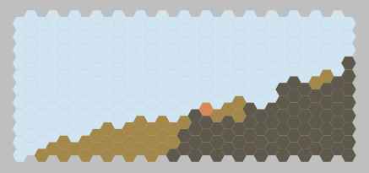
Landlab: grid management
Grids are objects
Grids use flat arrays
Data fields can be attached to grid elements
Multiple grid types
Built-in numerical functions:
gradient
divergence
VORONOI / DELAUNAY
RASTER
RADIAL
HEXAGONAL

Slide 11
grid = RasterModelGrid(shape=(10, 16))
NODE
LINK
CELL
grid = HexModelGrid(
shape=(16, 10),
node_layout=‘rect’,
orientation=‘vertical’)
grid = HexModelGrid(shape=(11, 10))
grid = RadialModelGrid((3, 5))
Delaunay triangulation
with Voronoi polygons

Slide 12
Building a model with Landlab components
Output
Parameters
Data
DRIVER
(Python script)
COMPONENT 1
COMPONENT 2
…
COMPONENT N
GRID
…
FIELD 1
FIELD 2
FIELD N

Slide 13
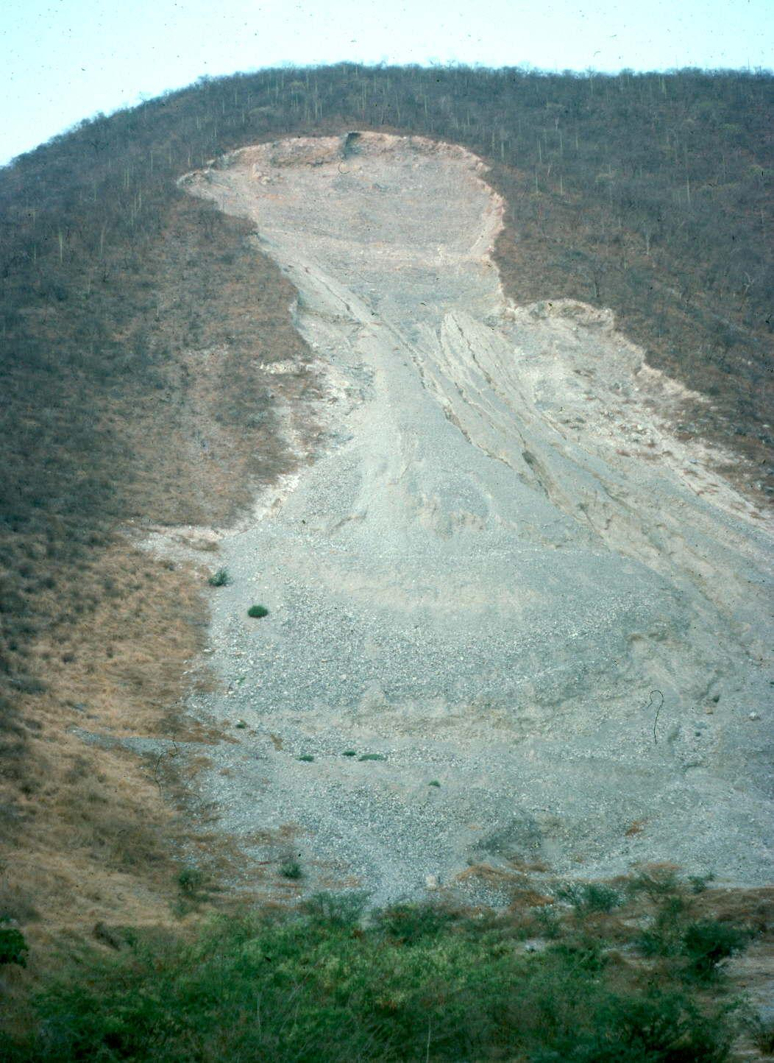
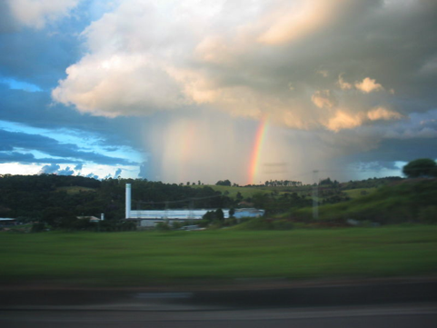
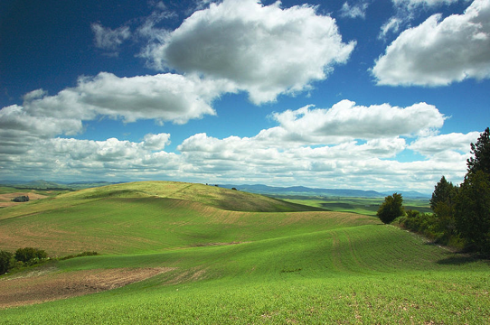
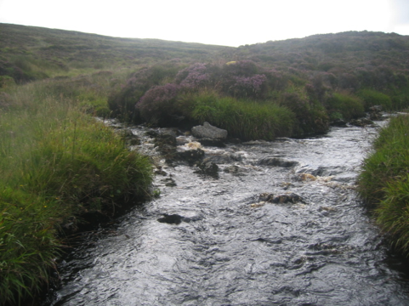
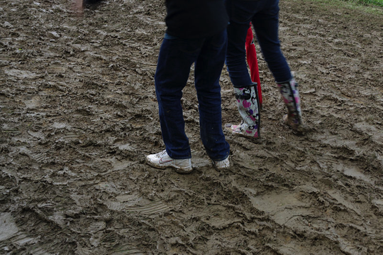

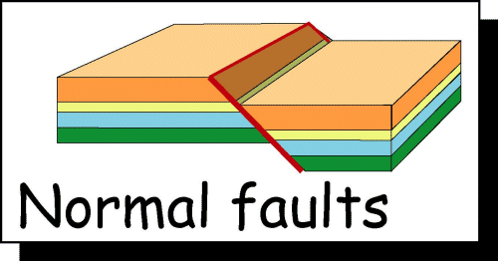
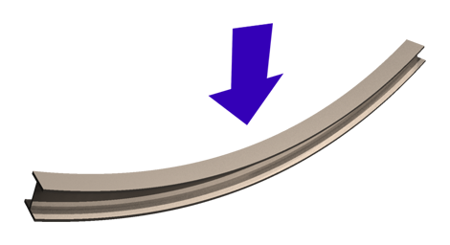
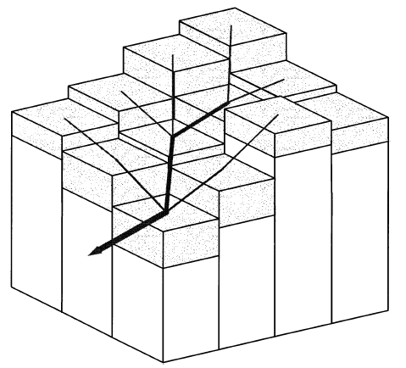
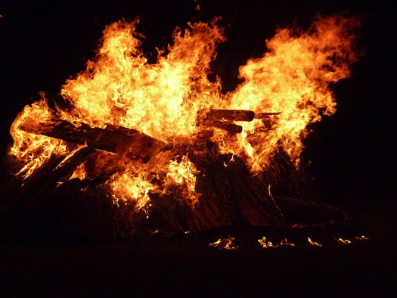
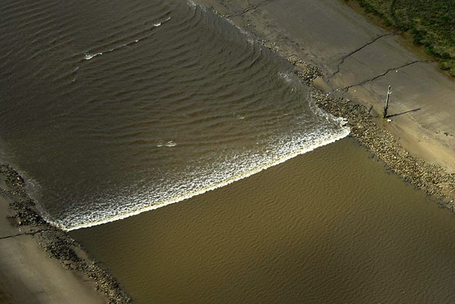
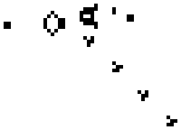
Some process components in the toolkit
STOCHASTIC
STORM GENERATION
SOIL CREEP
CHANNEL INCISION
LANDSLIDE PROBABILITY
SOIL MOISTURE
DYNAMICS
LITHOSPHERE
FLEXURE
VEGETATION GROWTH
NORMAL FAULTING
SHALLOW-WATER
HYDRODYNAMICS
FLOW ROUTING
STOCHASTIC
FIRE GENERATION
CELLULAR
AUTOMATA

Slide 14
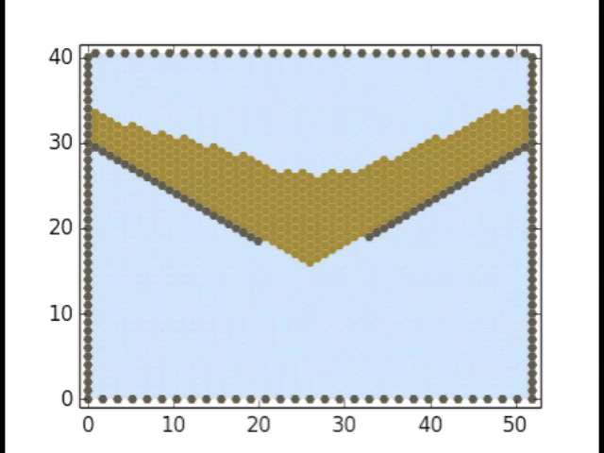
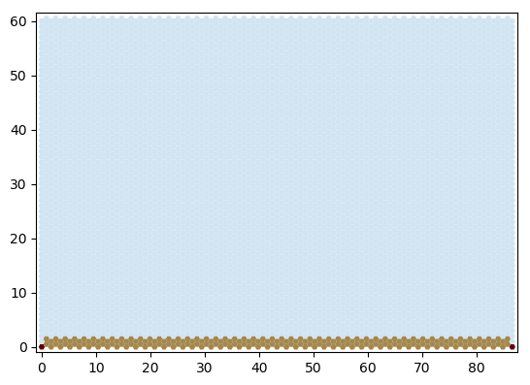
Cellular automaton package
CellLab-CTS: Continuous-time stochastic CA
(Tucker et al., 2016 Geoscientific Model Development;
2018 Earth Surface Dynamics)

Slide 15
Other handy tools
Input and output
Parameter input from formatted text file
Read and/or write gridded data:
ESRI ASCII
netCDF
DEM analysis and pre-processing
Configure “watershed” boundary conditions
Other terrain analysis functions
Basic plotting with Matplotlib
EX: (mygrid, topo) = read_esri_ascii(‘my_dem.txt’)

Slide 16

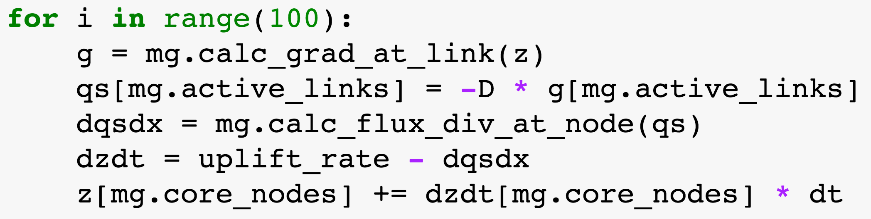
Example: 6-line diffusion model

Slide 17
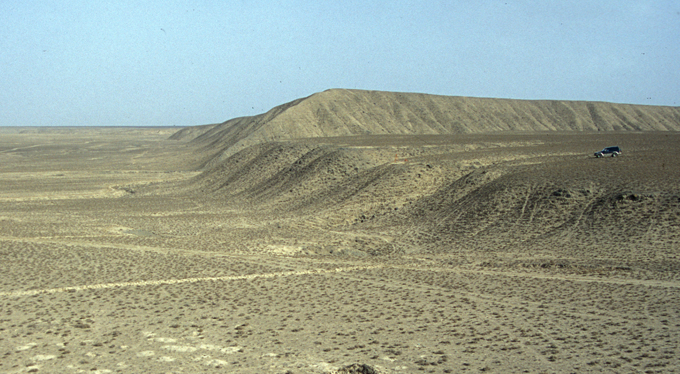
Tutorial #1: modeling the erosional degradation of a fault scarp using linear diffusion theory

Slide 18
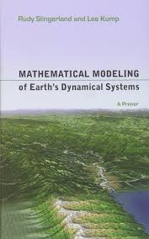
SOIL MASS IS CONSERVED ➔
SOIL CREEPS DOWNHILL ➔

Slide 19
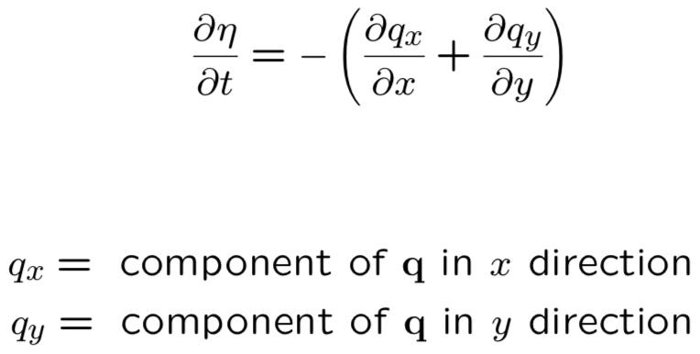
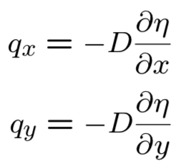
SOIL MASS IS CONSERVED ➔
SOIL CREEPS DOWNHILL ➔

Slide 20
Imagine a world of cells
Δx
Δx
Model will keep track of soil volume inside each cell

Slide 21
Inside each cell is a node
Model will keep track of land surface height at each node

Slide 22
Add a ring of boundary nodes

Slide 23
Number the nodes from lower left to upper right
24
25
26
27
28
29
18
19
20
21
22
23
12
13
14
15
16
17
6
7
8
9
10
11
0
1
2
3
4
5

Slide 24
Definition: q
Volume soil flux per width per time across a cell face [m²/yr]
Positive if flow is to east or north
Negative if flow is to west or south

Slide 25
Soil volume balance
Soil volume in a cell is height times surface area, or η Δx²
Time rate of change of soil volume at cell i is the sum of inflows/outflows across the four faces
If inflow rate per unit width for a given face is q, then total volume inflow rate is q times width, or q Δx

Slide 26
Soil volume balance
q_{west} Δx

Slide 27
Soil volume balance
q_{west} Δx
q_{east} Δx

Slide 28
Soil volume balance
q_{west} Δx
q_{east} Δx
q_{south} Δx

Slide 29
Soil volume balance
q_{north} Δx
q_{west} Δx
q_{east} Δx
q_{south} Δx

Slide 30
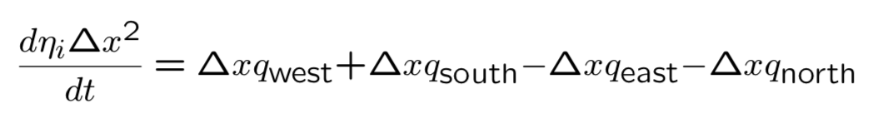
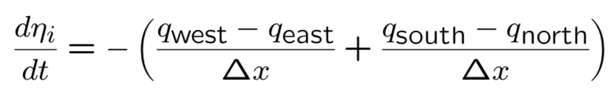
Soil volume balance: math for this finite volume scheme
Now, how do we calculate q?

Slide 33
Some notebook demos from the Landlab tutorials collection These and other tutorials can be found via the Landlab website: http://landlab.github.io

